Slide 1
Lecture 1 Introduction

Slide 2

Outline
What is an information system?
Role of (IT) Business Analyst
Methodologies, Models, Tools, and Techniques
Stages in building information systems

Slide 3
What is an information system?
What is an information system?
Role of (IT) Business Analyst
Methodologies, Models , Tools and Techniques
Disciplines
Successful System Development

Slide 4

Collection of inter-related components
Use to complete a business task

Slide 5

Crucial to the success of modern business organizations

Slide 6

Systems are built to make the business more competitive

Slide 7
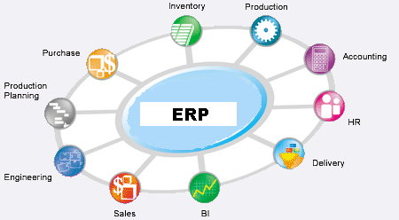
Information Systems
Let you manage various aspects of a business

Slide 8
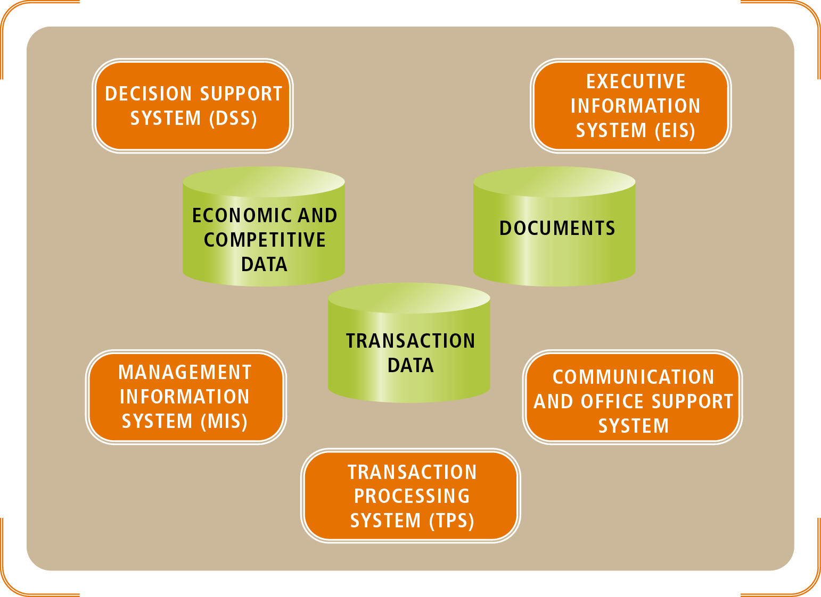
Types of Information Systems
Notes:
Transaction Processing System (TPS) capture and record information about the transactions that affect the organization. A transaction occurs each time a sale is made, each time supplies are ordered, and each time an interest payment is made. Usually these transactions create credit or debit entries in accounting ledgers. They eventually end up on accounting statements used for financial accounting purposes, such as the income statement.
Management Information Systems (MIS) are systems that take information captured by transaction processing systems and produce reports that management needs for planning and controlling the business. MIS are possible because the information has been captured by the TPS and placed in organizational databases.
Executive Information Systems (EIS) provide information for executives to use for monitoring the competitive environment and for strategic planning. Some of the information comes from the organizational databases, but much of the information comes from external sources – news about competitors, stock market reports, economic forecasts, etc.
Decision Support Systems (DSS) allow a user to explore the impact of available options or decisions. Sometimes this process is referred to as “what if” analysis, because the user asks the system to answer questions such as “What if sales dip below $100 million during the third quarter and interest rates rise to 7.5%? Financial projections made by the DSS can then explore the results. Some decision support systems are used to make routine operational decisions, such as how many rental cars to move from one city to another for a holiday weekend based on estimated business travel patterns.
Communication Support Systems allow employees to communicate with each other and with customers and suppliers. Communication support now includes wireless personal digital assistants (PDAs), mobile phones with messaging and PDA features, anywhere anytime email, broadband Internet access, and desktop video conferencing.
Office Support System help employees create and share documents, including reports, proposals and memos. Office Support Systems also help maintain information about work schedules, appointments, and meetings.

Slide 9

What are some examples of Information Systems around you?

Slide 10
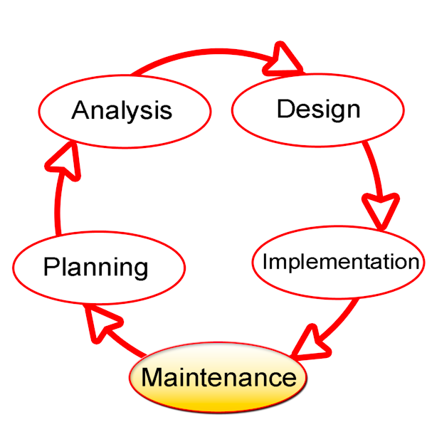
Developing Information Systems
Not just about programming!

Slide 11
Recall : Information System is used to complete a business task
i.e. Solve a Business Problem

Slide 12

Your Job (System Analyst/IT Business Analyst)
=
Solve Problems

Slide 13


Slide 14
Types of Problems
How to estimate based on parameters and suggest a production plan
Production needs to plan how much produce each week

Slide 15
Types of Problems
How to analyze consumer behaviors? Collect and analyze consumer’s opinion?
Marketing want to analyze consumer behaviors

Slide 16
Types of Problems
How to present data in a form ideal for analysis/planning/etc?
Management want to know the financial status of the company

Slide 17
Role of (IT) Business Analyst
What is an information system?
Role of (IT) Business Analyst
Methodologies, Models , Tools and Techniques
Disciplines
Successful System Development

Slide 18

Role of (IT) Business Analyst
Perform Business Analysis
Identify the business needs
Develop
/Implement solutions

Slide 19

Non-IT BA
Works in the context of the business
Process Improvement, Cost Cutting, etc

Slide 20
IT BA
Works in the context of IT projects
Liaises with business and technical stakeholders
Requirement analysis and designing systems
Notes:
Liaises: liên lạc

Slide 21

Stakeholders
Person or organization affected by a project
Can be users, customers (who do not use the system directly)

Slide 22
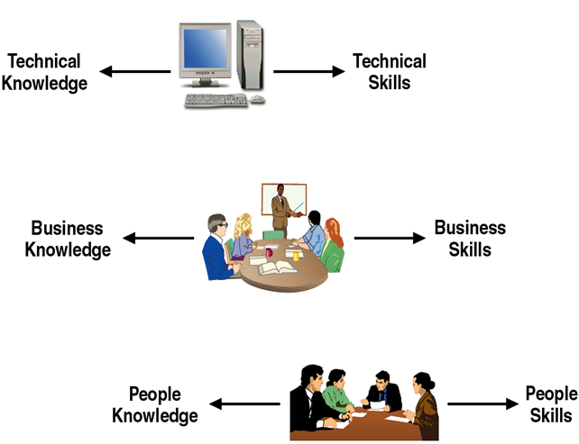
Knowledge and skills required of an IT Business Analyst

Slide 23


Technical Knowledge and Skills
Computers and How it works
-DUH?!

Slide 24
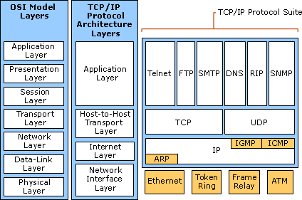
Technical Knowledge and Skills
Networks and Protocols

Slide 25
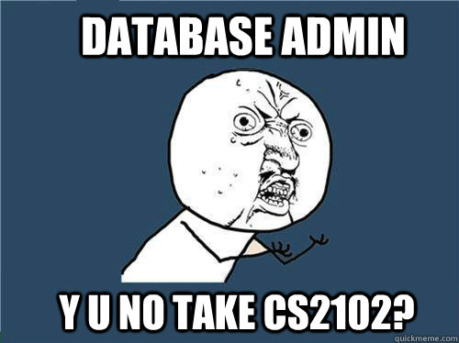
Technical Knowledge and Skills
Database and database management system

Slide 26
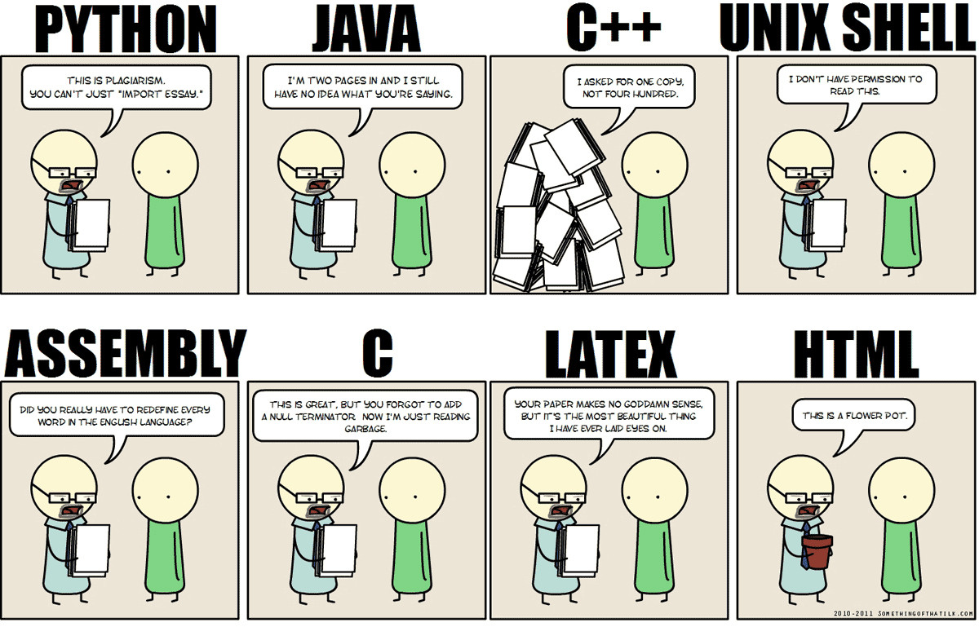
Technical Knowledge and Skills
Programming languages (Object-Oriented)

Slide 27
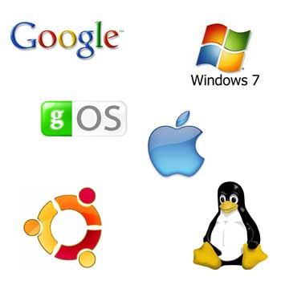
Technical Knowledge and Skills
Operating Systems and Utilities

Slide 28

Business Knowledge and Skills
What are the business functions the organization perform?
How is the organization structured?
How is it managed?

Slide 29

Business Knowledge and Skills
Need to understand:
the organization
its culture
its mission
its objectives

Slide 30

People Knowledge and Skills

Slide 31

People Knowledge and Skills
Need to understand how people think

Slide 32

People Knowledge and Skills
Need to understand how people learn

Slide 33

People Knowledge and Skills
Need to understand how people react to change

Slide 34

People Knowledge and Skills
Communicate: Interviewing Techniques

Slide 35
Methodologies, Models, Tools and Techniques
What is an information system?
Role of (IT) Business Analyst
Methodologies, Models , Tools and Techniques
Disciplines
Successful System Development

Slide 36
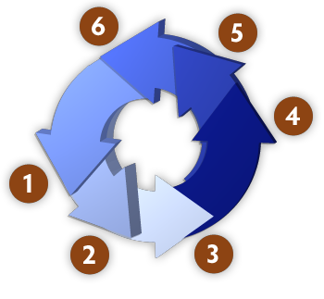
Methodology
System Development Methodology:
Set of guidelines to follow for completing every activity in the development process

Slide 37
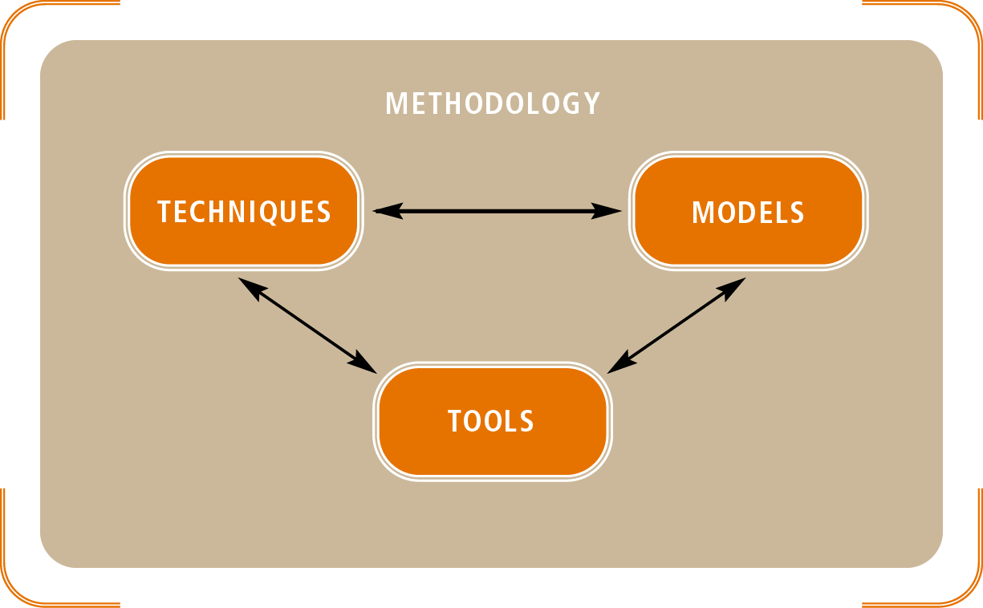
Methodology
Consists of Models, Tools &
Techniques

Slide 38

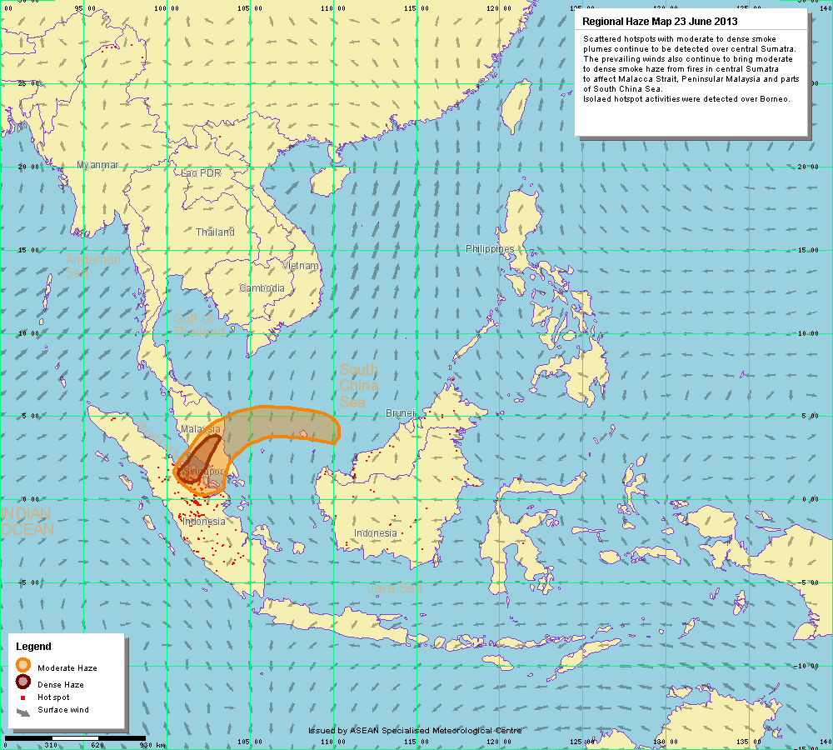
Models
Equations, Diagrams, Charts etc
Abstract representation of an aspect of real-world

Slide 39

Models use in System Development
Unified Modeling Language (UML)
Standard set of model constructs
Designed for Object-Oriented development

Slide 40
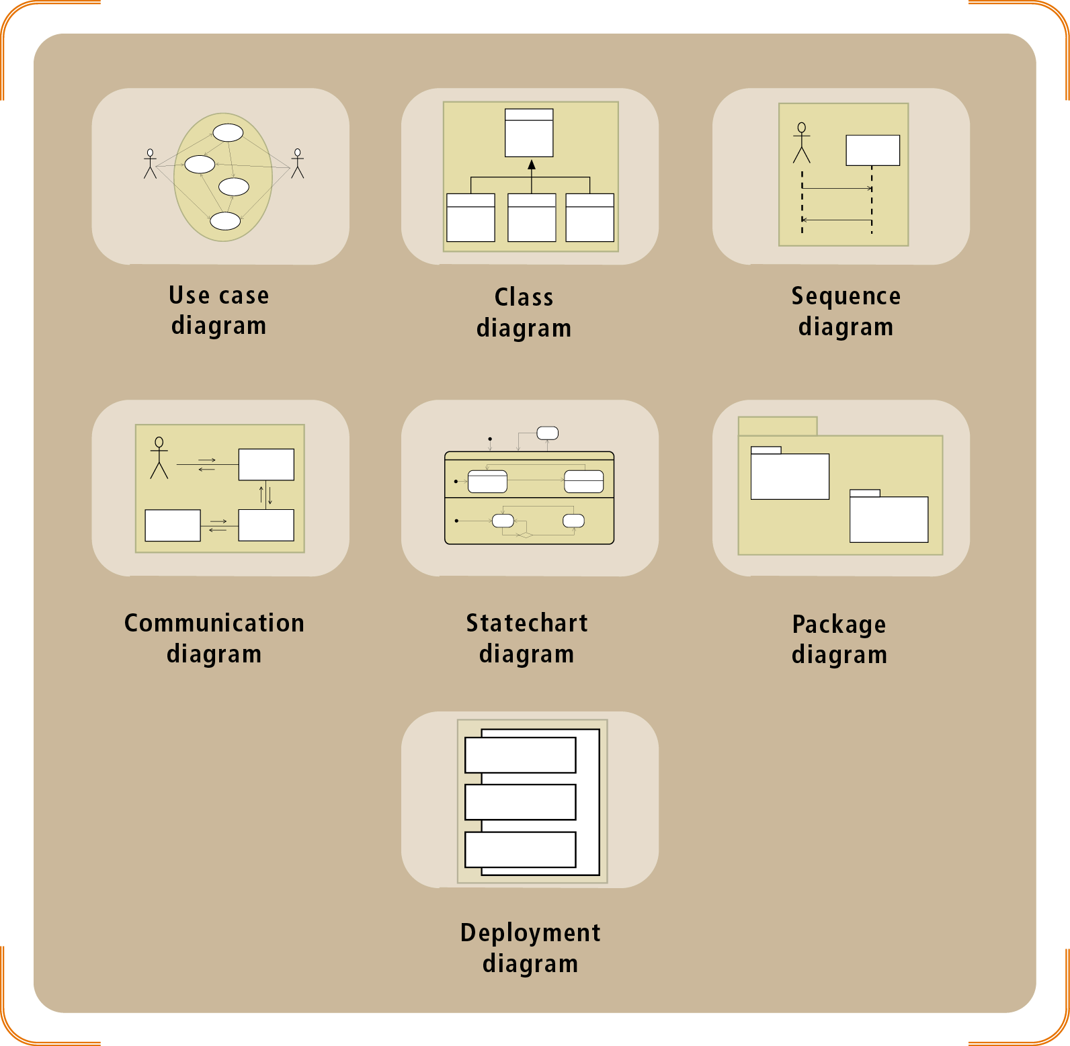
UML diagrams used for modeling

Slide 41




Tools
Integrated Development Environment (IDE)

Slide 42

Tools
Computer Aided System Engineering (CASE)
Store information about system specification
Aid in various aspects of system development
Modeling, code generator, documentation tools

Slide 43

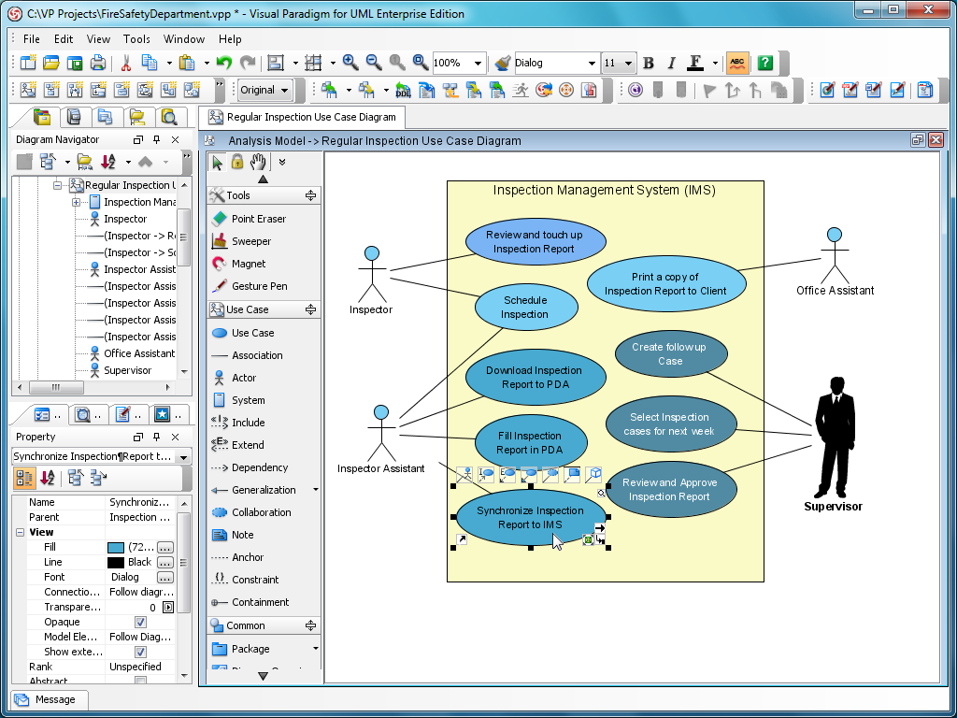
Tools
UML Drawing Tool

Slide 44
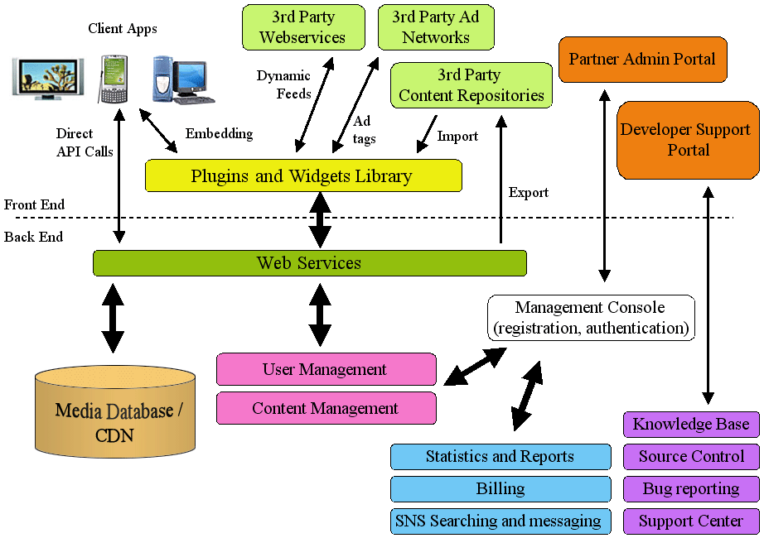
Techniques
System Architecture Design
Network Configuration Design
Database Design

Slide 45

Techniques
Cost/Benefits Analysis
Project Planning Techniques

Slide 46

Techniques
Set of guidelines for completing an activity
Examples:
Domain-modeling, use case modeling, software-testing, etc

Slide 47
Disciplines
What is an information system?
Role of (IT) Business Analyst
Methodologies, Models , Tools and Techniques
Disciplines
Successful System Development

Slide 48
disciplines
Business Modeling
Requirements
Design
Implementation
Testing
Deployment

Slide 49

Business Modeling
Objective: Understand business environment and potential improvements
Objective: Communicate this understanding to the end users, manager, system developer, etc

Slide 50

Requirements
Objective: Understand and document the business needs

Slide 51

Requirements
Business Modeling + Requirements traditionally referred to as System Analysis

Slide 52
Requirements
Activities:
Gather detailed information
Define functional requirements
Define non-functional requirements
Prioritize requirements
Develop user interface dialogs
Evaluate requirements with users
Etc
Examples? (10’) (here ……….. Lession 1 08/01/2019)

Slide 53

Design
Objective:
Design the system (based on the requirements)

Slide 54
Design
1. High-Level Design: components, architecture of system
2. Low-Level Design: Classes, Methods, interface

Slide 55
Design
What to design?
Support services architecture and deployment environment
Software architecture
Use case realizations
Database
System and user interfaces
System security and controls
Etc
Examples? Design interface and class for Student information management (10’)

Slide 56

Implementation
Building, Acquiring, Integrating Software Components
Example: Coding Student information management

Slide 57

Testing
Work with users to ensure that the system fulfills the requirements

Slide 58
Testing
Activities:
Define and conduct unit testing
Define and conduct integration testing
Define and conduct usability testing
Define and conduct user acceptance testing
Etc
Examples: Give some test case for above problem.

Slide 59
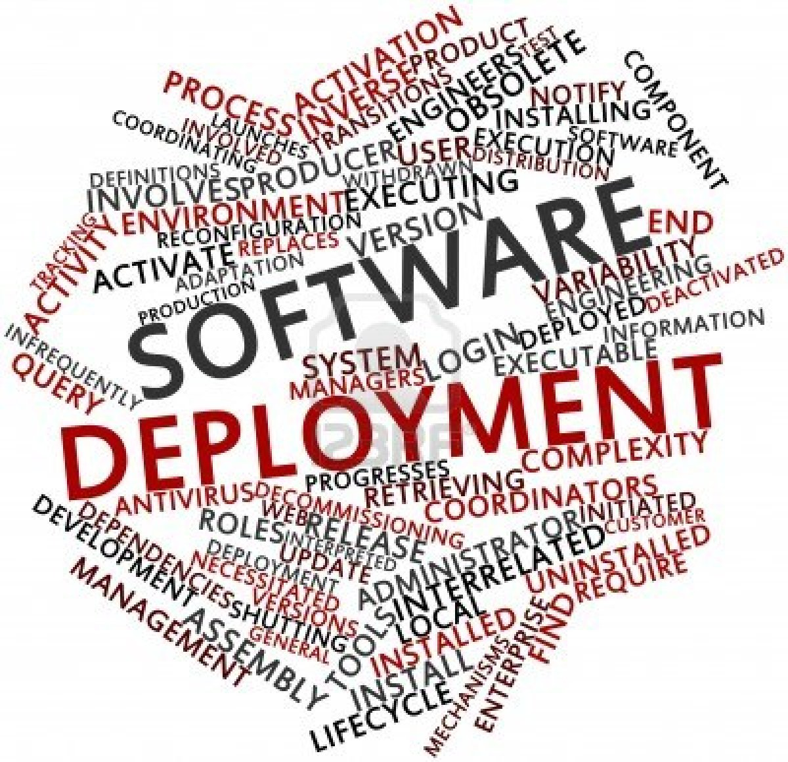
Deployment
Make system operational

Slide 60
Deployment
Activities:
Acquire hardware and system software
Package and install components
Train users
Convert and initialize data
Etc
Examples: Give some examples for this case.

Slide 61
Successful System Development
What is an information system?
Role of (IT) Business Analyst
Methodologies, Models , Tools and Techniques
Disciplines
Successful System Development

Slide 62

Successful System Development
Thorough System Analysis and Design

Slide 63
The Problem With Communication

Slide 64





How the Customer explained it.
How the Project Leader understood it.
How the Designer designed it.
How the Programmer wrote it.
How the IT Business Analyst described it.

Slide 65
The Final Outcome

Slide 66
Recap
Introduction to Information Systems
Role of IT Business Analyst
Some definitions: methodologies, models, tools and techniques
Various stages/discipline to system development: business modeling, requirements, design, implementation, testing, deployment

Slide 67
What’s Next?
Systems Development Life Cycle (SDLC)
Business Modeling

Slide 68
Về nhà buổi 1 chuẩn bị
Nhóm 2 thành viên
In slide.
Ít nhất 10 tờ giấy A4.

